Slide 1


Slide 2
THOCC – ECCCM 12 - PROJECT & PROGRAM MGMT MODULE
Christophe Vandecaveye

Slide 3

Agenda
13.30h - 14.00h : THEORIE & VERBANDEN MET CC OPERATING MODEL
14.00h - 16.00h : PROJECT MANAGEMENT MANIEREN & MENSEN
        Project Management essentials
        Project Risk Management
        The Project Manager Profile
16.00h – 16.30h : PAUZE
16.30h - 18.30h : SPEELTIJD
18.30h – 19.00h : PAUZE
19.00h – 20.00h : PROGRAM MANAGEMENT & P³MO
20.00h – 20.30h : AFSLUITEN

Slide 4
Theoretical Background

Slide 5
Success versus Failure in projects
Why projects succeed
Why projects are challenged
Why Projects Fail
(16 %)
(53 %)
(31 %)
1. User involvement
2. Exec.Mgt. support
3. Clear requirements
4. Proper planning
5. Realistic expectations
6. Smaller milestones
7. Competent staff
8. Ownership
9. Clear Vision & Objective.
.
10. Hard work/focused
15.9 %
13.9 %
13.0 %
9.6 %
8.2 %
7.7 %
7.2 %
5.3 %
2.9 %
2.4 %
1. Lack of User Input
2. Incomplete Requirements
3. Changing Requirements
4. Lack of Exec. Support
5. Techn. Incompetence
6. Lack of resources
7. Unrealistic Expectations
8. Unclear Objectives
9. Unrealistic timeframes
.
10. New Technology
12.8 %
12.3 %
11.8 %
7.5 %
7.0 %
6.4 %
5.9 %
5.3 %
4.3 %
4.3 %
1. Incomplete Requirements
2. Lack of User involvement
3. Lack of resources
4. Unrealistic Expectations
5. Lack of Exec. Support
6. Changing Requirements
7. Lack of Planning
8. Didn’t need any longer
9. Lack of I.T. Mgt.
10.Technology Illiteracy
13.1 %
12.4 %
10.6 %
9.9 %
9.3 %
8.7 %
8.1 %
7.5 %
6.2 %
4.3 %
Source : The Standish Group

Slide 6
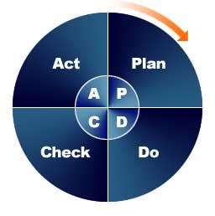

PM models
All models are wrong, but some are useful ! (Deming)

Slide 7


PM models
7 principles & 7 themes
Continued business justification
Learn from experience
Defined roles & responsibilities
Manage by stages
Manage by exception
Focus on products
Tailor to suit the project environment
Business case
Organization
Quality
Plans
Risk
Change
Progress

Slide 8
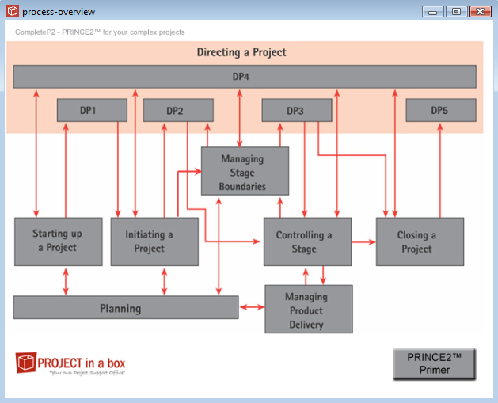
7 distinctive (project) management processes
interacting at 4 management levels …
PM models

Slide 9
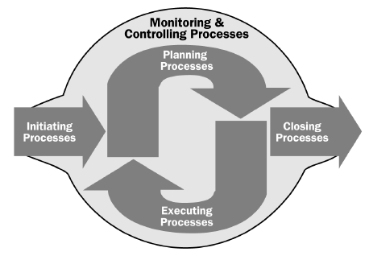

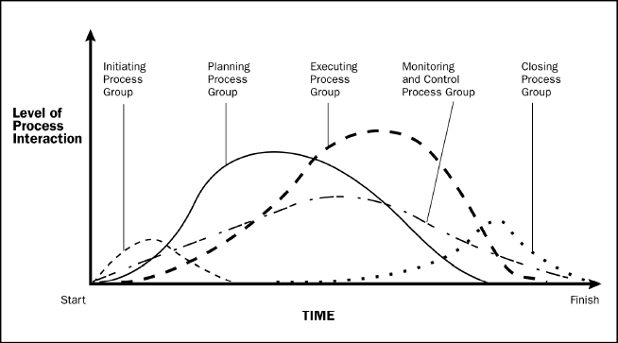
PMBoK

Slide 10
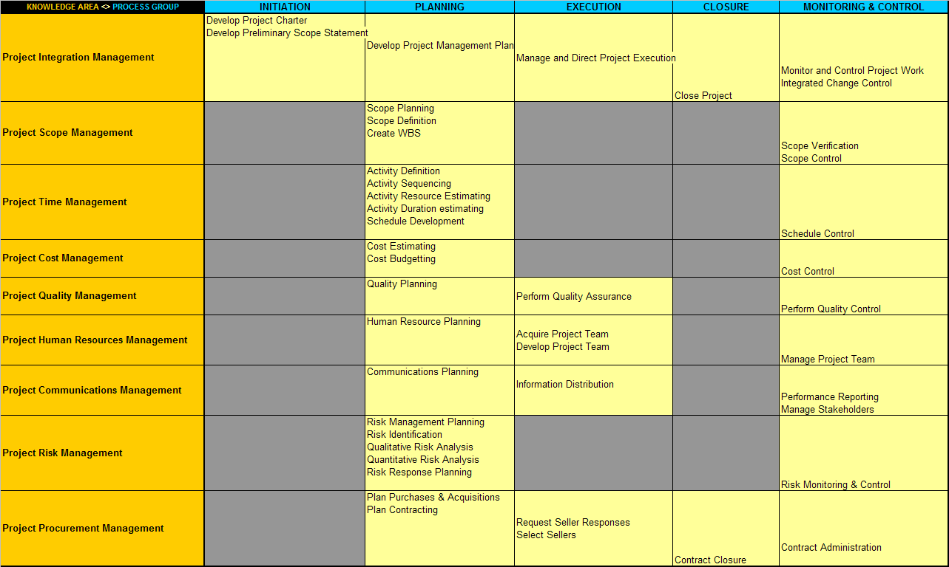


PMBoK - 4th edition
PM models - PMBoK
we listen. we think. we consult. we act… with you.

Slide 11
CC Operating Model

Slide 12
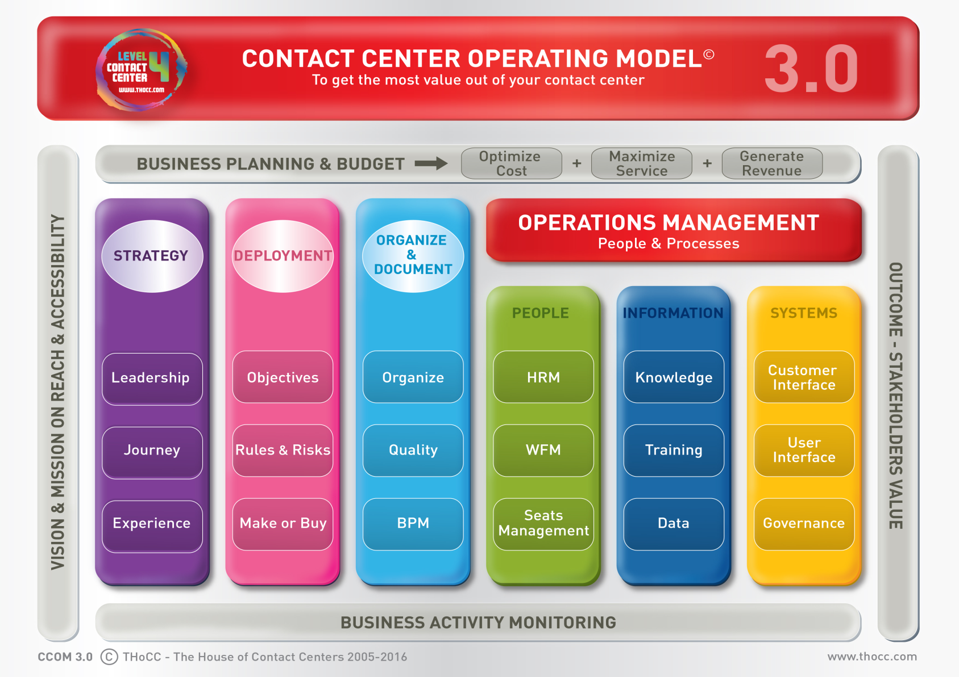
PPM ~ improve
PPM ~ build

Slide 13
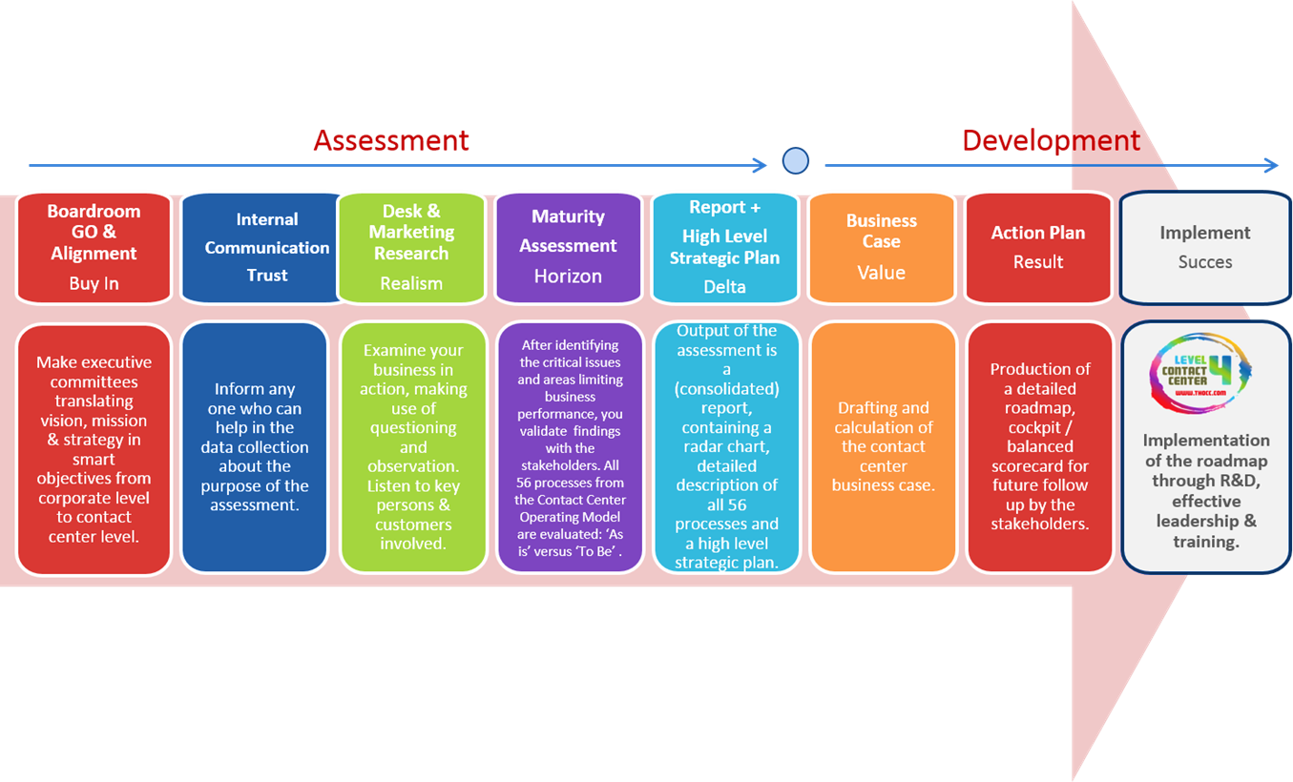
PPM ~ improve
PPM ~ build

Slide 14
Project Management Essentials

Slide 15
From Business Case to ...
Project Charter or Project Initiation Document
“A description of …
… the justification for …
… starting, continuing or stopping the project”
Business Reasons & Objectives
Options considered & calculated
Benefits estimated & expected timescales
Assumptions & Risks (key risks of the project)
Scope & expectation descriptions
Budget
Planning (minimum : milestones)
Project organisaton, roles & responsibilities
Formal project authorisation(s)
Project approach, governance & methodology
PMBOK
Prince2
Business Case
BC KEY NOTIONS:
Break-even point
Payback-period
CC/WACC
NPV
ROI
Project
Charter / PID

Slide 16
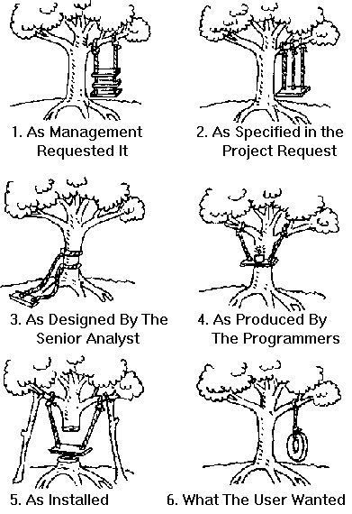
Be clear on deliverables …
WORK
BREAKDOWN
STRUCTURE
-
PMBOK
PRODUCT
BREAKDOWN
STRUCTURE
-
Prince2

Slide 17
Objectives ? What the **** ?
Business Objectives <> Project Objectives
  Profit
  Market share
  Customer satisfaction
  Employee satisfaction
  Shareholder value
  …
SCOPE
QUALITY
determine the
primary driver
TIME / SCHEDULE
COST / BUDGET

Slide 18
Define/review your baselines
SCOPE BASELINE
SCHEDULE BASELINE
BUDGET BASELINE

Slide 19
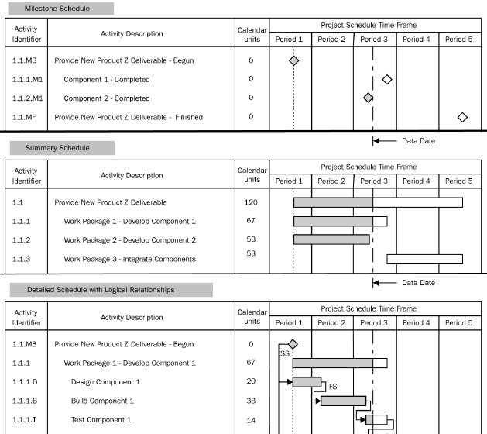
Project Planning : milestones
KEYWORDS:
Internal
External
Dependencies
Constraints
Imposed
Deliverable !
Result !

Slide 20

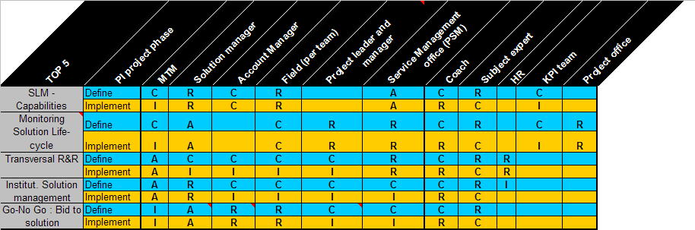
Roles & Responsibilities
Must be completed & clarified during project planning !
RACI-method :
  R = Responsible
  A = Accountable
  C = Consulted
  I = Informed

Slide 21

Stakeholder management
IMPACT
COMMIT
INVOLVE
INFORM
SMILE & IGNORE
INTEREST

Slide 22
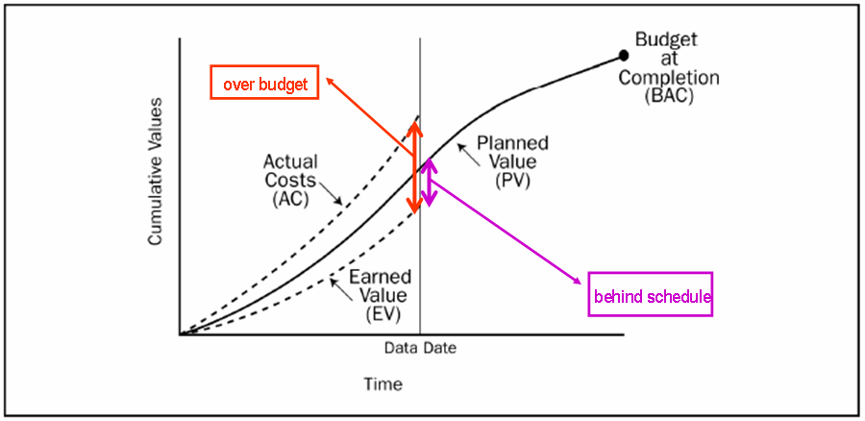

Project Performance Reporting :
Collect the facts and look back …
… but run forward !

Slide 23
Project Risk Management

Slide 24

Your attitude towards risk … let’s discover !
GAMBLE 1 - which option do you take:
  Win 1000 EUR for sure
  Toss a coin with
    50% chance of winning 0 EUR
    50% chance of winning 2000 EUR
Humans react inconsistently towards uncertainty & risk depending on:
personal preference
gain or loss situations
personal involvement
In order to perform a consistent project risk management, we will:
clearly define project risks
scale & visualize project risks
create an interactive & iterative process for risk management
GAMBLE 2 - which option do you take:
  Loose 1000 EUR for sure
  Toss a coin with
    50% chance of loosing 0 EUR
    50% chance of loosing 2000 EUR

Slide 25

What is a project risk ?
uncertain
  A project risk is an uncertain event or condition that, if it occurs, has a positive or a negative effect on at least one project objective (scope, schedule, budget) - PMBOK.
project objective

Slide 26



Risk defined in 3 dimensions
Impact
Probability
Urgency

Slide 27
Identify, prioritize, act ... step-by-step
Identify positive & negative risks
Assess impact, probability & urgency
Prioritize
Define actions
Follow-up & repeat, repeat, repeat, …

Slide 28
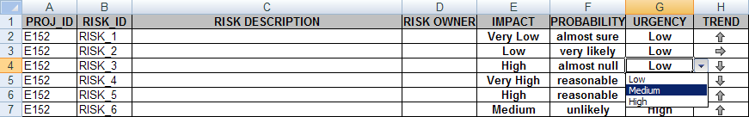
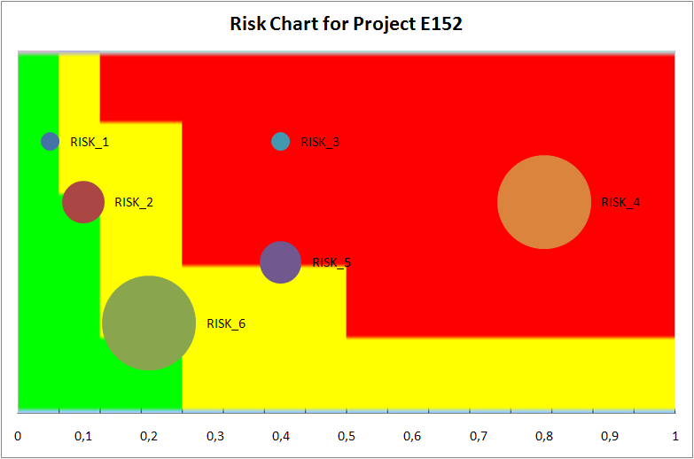
Visualize & analyze regularly … in team !
EXAMPLE

Slide 29
Risk Response Strategies
Strategies for negative risks or threats
  Avoid - make sure the risks doesn’t occur
  Transfer - transfer the risk responsibility to a 3d party
  Mitigate - reduce impact and/or probability of the risk
Strategies for positive risks or opportunities
  Exploit - make sure the risks does occur
  Share - engage a 3d party who is more able to grab the benefit
  Enhance - increase impact and/or probability of the risk
Strategies for both positive threats and opportunities
  Active acceptance
  Passive acceptance

Slide 30
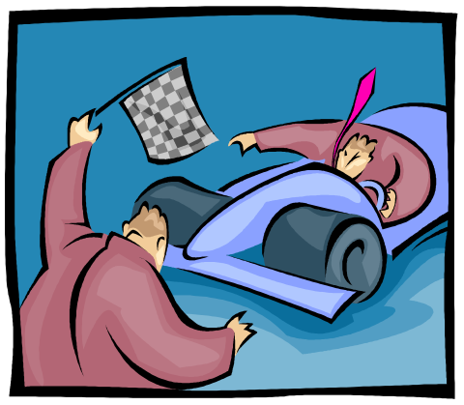
NOT DONE in risk management
Believing that Risk Management removes the risk
Making the assumption that all assumptions are right
Thinking that the job is done with 1 risk assessment at the beginning of the project
Over-relying on mathematics and/or data estimates
Trusting that standard questionnaires provide the right questions at the right time for your project
Limiting yourself to a risk identification and waiting for the identified risks to happen
Defining risks without assigning a clear owner
Doubting a certain problem & being sure about an uncertain risk
Being convinced that your gut-feel represents reality
Keeping it silent !

Slide 31
The Project Manager Profile

Slide 32
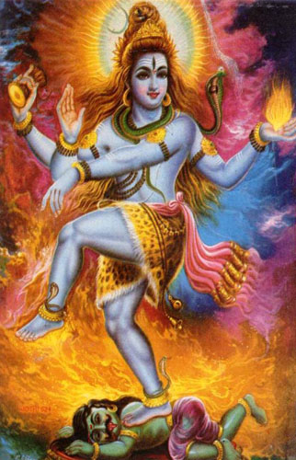
Required skills for a Project Manager
Budgetting
Organisation
Communication
Planning
Leadership
Negotiation
Team Building
A PM is human !

Slide 33
The top skill of the skills …
What % of a project manager’s time goes into communication ?
  15 %
  50 %
  75 %
  85 %
  Communication is not a prime task for the project manager
E = M * C
2
85 %

Slide 34



BREAK

Slide 35


SPEELTIJD
Come out & play …
Project & Programme Management

Slide 36
SITUATION 1 – TEAM 1
Your organisation is launching a new product-line
We are 3 months before launch
An external Project Manager is running the project
The Project Manager visits you for a short meeting thereby revealing that your CC is not included in his plan for the moment
This point was indicated to him by the CIO
The CEO does not want to delay nor cancel the launch because of this “minor issue” (quote) and has planned a press conference next week to announce the new product-line …
Your mission is to perform & present a risk analysis for this situation, including a risk management plan !

Slide 37
SITUATION 2 – TEAM 2
Based on a sound business case & after agreement with your CEO with whom you have an excellent contact, you have decided to outsource a part of your Contact Centre
One of the assumptions of the business case is that the outsourcing is a fact within a year from now
A shortlist of potential outsourcing partners exists
A kick-off meeting should be organised for the project team – which doesn’t exist yet as you (nor the CEO) didn’t communicate your plans to the organisation until now …
Your mission is to list the attendees for this kick-off meeting & present your action plan at this kick-off meeting !

Slide 38
SITUATION 3 – TEAM 3
Based on one of his briljant ideas, your CEO has decided to outsource a part of your Contact Centre
He has already appointed an external Project Manager (from a close friend’s company) who will report directly to you
Via his extended business network, the CEO has already selected your outsourcing partner
Your CEO expects you to be ready before next summer …
Your mission is to present a roadmap for this project , including the exact roles & responsibilities of all stakeholders !

Slide 39
BREAK

Slide 40
Program Management & P³MO

Slide 41
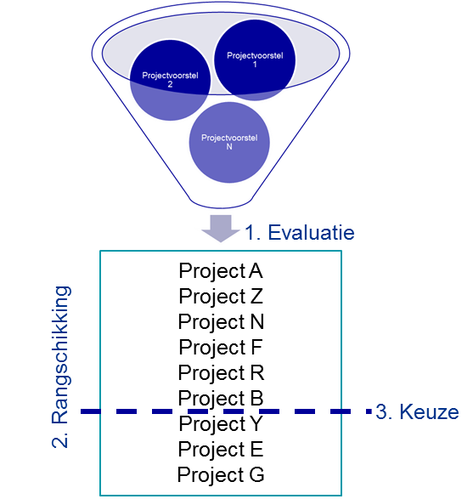
THINK TOP-DOWN, BUILD BOTTOM-UP
STRATEGY
PORTFOLIO
BENEFITS
PROGRAM
OBJECTIVES
PROJECT

Slide 42
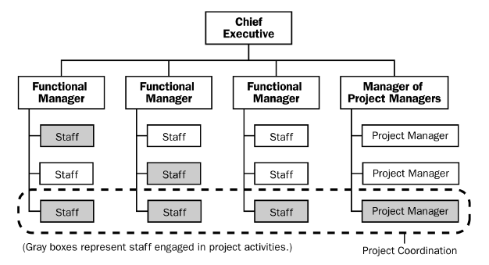
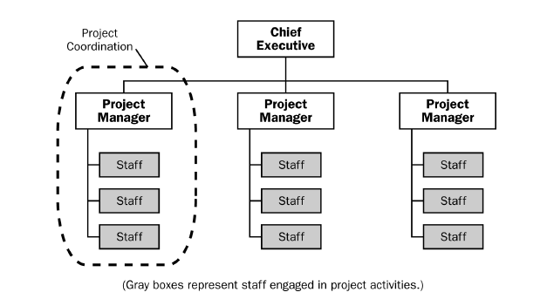
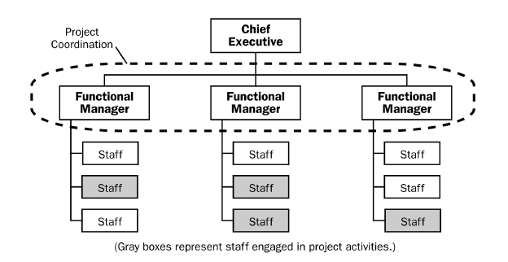
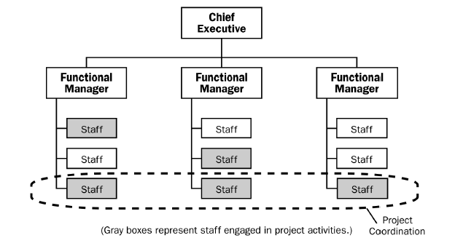
Influence of organisational structures
projectised
PPM authority
matrix
functional
Resource availability

Slide 43

P³MO : Project – Program - Portfolio
Align portfolio and strategy
Insights in project/ program mgt information and basic risk management
Optimize processes and tools
Set project/ program management processes and tools
Shape roles and capabilities
Define basic roles, capabilties and governance
Control performance
Monitor project performance
(re- active)
Share
knowledge
Manage project and portfolio management documentation centrally
Facilitate the decision making proces: project classification and selection
Strategic alignment and benefits management
Set portfolio management processes and tools
Integrate portfolio and project management processes
Develop roles, capabilties and governance
Monitor portfolio performance
(re- active)
Standardize project management documentation
Share knowledge pro-active
“Learning organization”
Integrate roles, capabilties and governance
Optimize project and portfolio performance
(pro active)

Slide 44

Find more P’s !
P 1-3 : Project, Program, Portfolio (classics)
P 4-11 : Proper Planning & Preparation Prevents Piss Poor Performance (Andy McNabb)
P12 : Politics
P13 : disciPline

Slide 45
Literature on project management

Slide 46

Websites:
  PMI : http://www.pmi.org
  Prince2 : http://www.ogc.gov.uk/methods_prince_2.asp
Project Management literature:
  Project Management Handbook – Harold Kerzner
  Principles of Project Management – John R. Adams
  Quality Management for Projects and Programs – Lewis R. Ireland
  Organizing Projects for Success – Vijay K. Verma
  The Magic Megaphone – Nick Montoya
  One project too many – Geoff Reiss & Geoff Leigh
  Human Resource Skills for the Project Manager – Vijay K. Verma
  Managing the Project Team – Vijay K. Verma
  Essential People Skills for Project Managers – S. W. Flannes & G. Levin
  Visualizing Project Management – K. Forsberg, H. Mooz & H. Cotterman
  Quantitative Methods for Project Management – Frank T. Anbari
  Managing High-Technology Programs & Projects - Russell D. Archibald
  Advanced Project Portfolio Management & the PMO – Kendall & Rollins
  Against the Gods, the remarkable story of risk – Peter L. Bernstein
Off the beaten track:
  The Dilbert Principle – Scott Adams
  The Art of War – Sun Tzu
  The First Crusade – Thomas Asbridge

Slide 47
QUIZ
1 | Welk percentage vertegenwoordigt “communicatie” in de tijdsbesteding van een project manager ?
2 | Welke omgevingen zullen een natuurlijke voorkeur hebben voor Prince2 in plaats van PMBOK ?
3 | Wat wordt er bedoeld met de baselines van een project ?
4 | Wat is de voornaamste reden tot mislukken van projecten ?
5 | Wat is de definitie van een projectrisico ?
6 | Wat is de skillset van de ideale project manager ?
7 | Wat is het belangrijkste argument om de beslissing te nemen om bepaalde projecten te groeperen in een programma ?

Slide 48

EXPERT CLASS
CONTACT CENTER MANAGEMENT
A COMPLETE CONTACT CENTER LEADERSHIP TRAINING
Thank You !

